Slide 1
Lecture 12 Minimum Spanning Trees
Department of Computer Science
Hofstra University

Slide 2
Lecture Goals
In this lecture we study the minimum spanning tree problem.
We consider two classic algorithm for the problem—Kruskal's algorithm and Prim's algorithm.
Both are greedy algorithms that are also optimal.

Slide 3
Minimum Spanning Tree (MST)
Given. Undirected graph G with positive edge weights (connected).
Def. A spanning tree of G is a subgraph T that is both a tree (connected and acyclic) and spanning (includes all of the vertices).
Goal. Find a min weight spanning tree.
4
24
4
24
23
9
23
9
6
18
6
18
5
11
5
11
16
8
16
8
10
14
7
10
14
7
21
Brute force.
Try all spanning trees?
21
graph G
not connected
4
24
4
24
23
9
23
9
6
18
6
18
5
11
5
11
16
8
16
8
10
14
7
10
14
7
21
21
not acyclic
spnning tree T: cost = 50 = 4 + 6 + 8 + 5 + 11 + 9 + 7

Slide 4
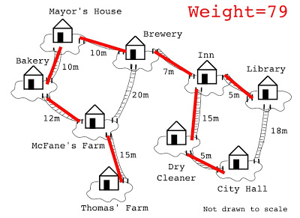
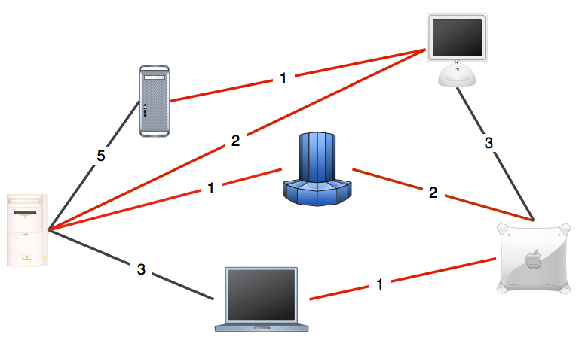
MST Applications
One example would be a telecommunications company trying to lay cable in a new neighborhood. If it is constrained to bury the cable only along certain paths (e.g. roads), then there would be a graph containing the points (e.g. houses) connected by those paths.
Some of the paths might be more expensive, because they are longer, or require the cable to be buried deeper; these paths would be represented by edges with larger weights.
A MST would be one with the lowest total cost, representing the least expensive path for laying the cable.
Network design.
Cluster analysis.
Indirect applications.

Slide 5
Kruskal’s Algorithm
Consider edges in ascending order of weight.
Add next edge to tree T unless doing so would create a cycle.
graph edges sorted by weight
does not create a cycle
creates a cycle
0 - 7 | 1
2 - 3 | 2
1 - 7 | 3
0 - 2 | 4
5 - 7 | 5
1 - 3 | 6
1 - 5 | 7
2 - 7 | 8
4 - 5 | 9
1 - 2 | 10
4 - 7 | 11
0 - 4 | 12
2 - 6 | 13
3 - 6 | 14
0 - 6 | 15
4 - 6 | 16
1
3
5
7
2
0
4
6
an edge-weighted graph
Kruskal's algorithm in 2 minutes
https://www.youtube.com/watch?v=71UQH7Pr9kU

Slide 6
Prim’s Algorithm
Start with vertex 0 and greedily grow tree T.
Add to T the min weight edge with exactly one endpoint in T.
Repeat until V – 1 edges.
1
6
3
7
3
11
5
2
5
7
2
8
15
9
12
1
4
0
14
4
13
16
17
6
Prim's algorithm in 2 minutes
https://www.youtube.com/watch?v=cplfcGZmX7I

Slide 7
Dijkstra’s Algorithm vs. Prim’s algorithm
Similarities:
Both use a greedy approach.
They employ similar data structures, often using a priority queue.
The basic structure of both algorithms is very similar, with the main difference being in how they update vertex values
Dijkstra's finds shortest paths, while Prim's constructs a minimum spanning tree (MST).
This is reflected in how they calculate and update vertex values:
In Dijkstra's algorithm, choose the closest vertex to the source node (via a directed path), the distance to a vertex is relaxed to sum of the edge weight plus the distance to the previous vertex if it is smaller.
In Prim's algorithm, choose the closest vertex to the tree (via an undirected edge), i.e., the vertex with the minimum weight of the edge connecting it to the MST.
Notes:
Dijkstra’s algorithm seem familiar?
Prim’s algorithm is essentially the same algorithm.
Both are in a family of algorithms that compute a graph’s spanning tree.
Main distinction: Rule used to choose next vertex for the tree.
Prim’s: Closest vertex to the tree (via an undirected edge).
Dijkstra’s: Closest vertex to the source (via a directed path).

Slide 8
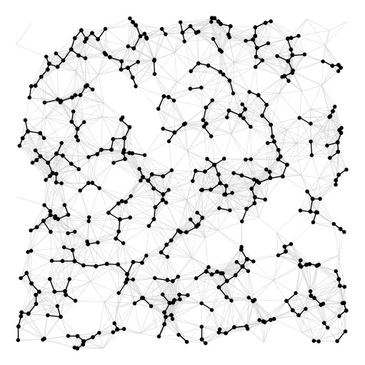
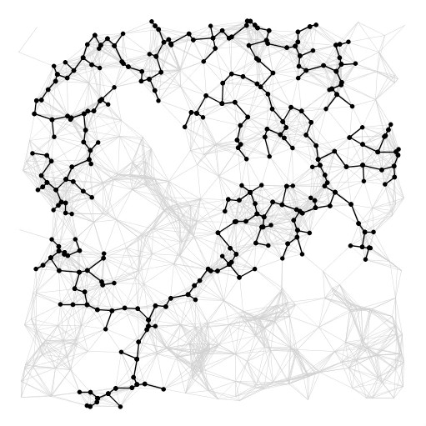
Summary
algorithm
visualization
bottleneck
running time
sorting union–find
Kruskal
E log V
Prim
priority queue
E log V
https://www.youtube.com/watch?v=vmWSnkBVvQ0

